Slide 1
System Overview
To Buoy
Controller &
Transceiver
Winch
Camera
Comms cable attached to winch (mechanism TBC)
Claw
Tracks
To Rover

Slide 2
Assigned Roles

Slide 3
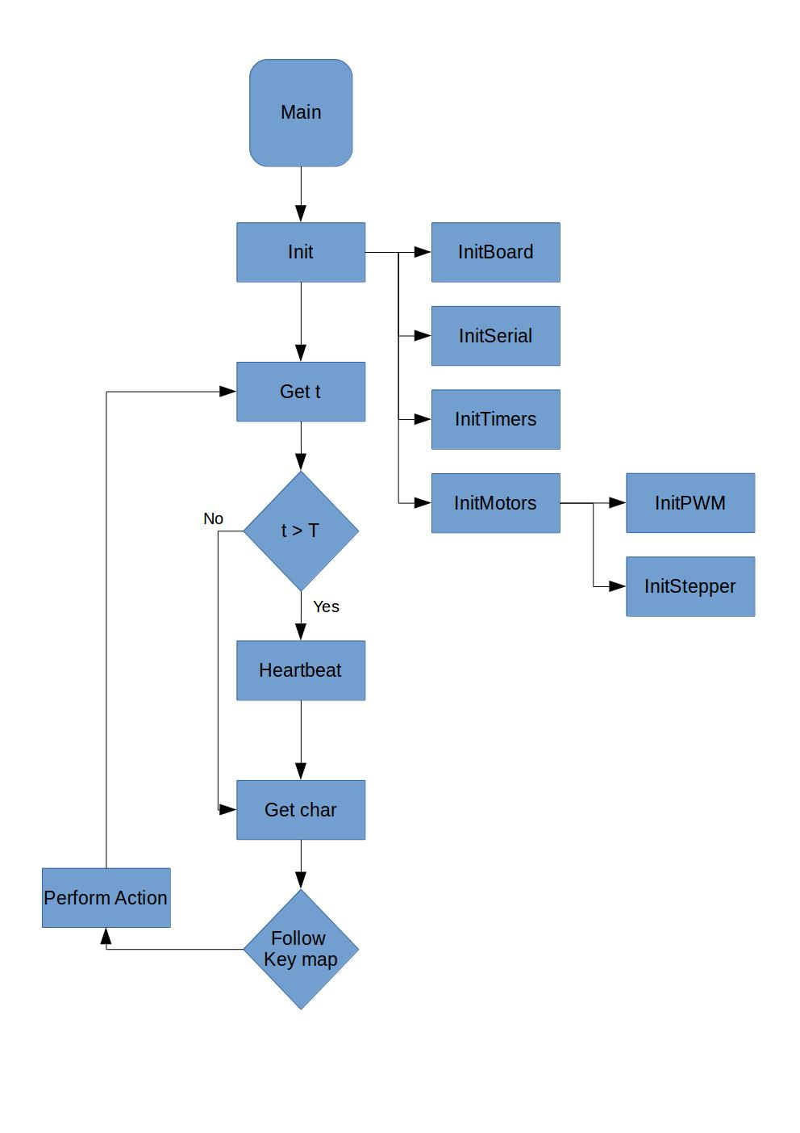
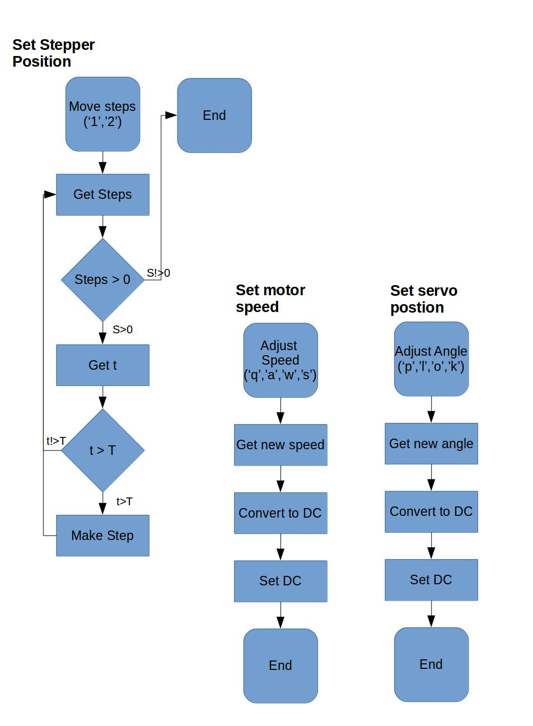
Program Flow

Slide 4
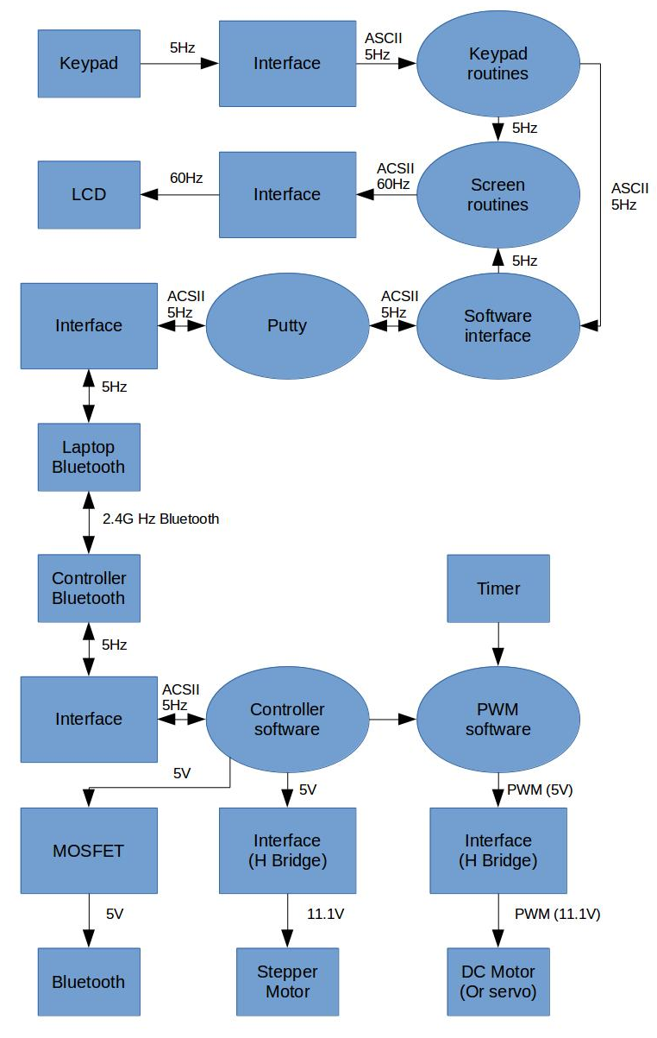
Signal Flow

Slide 5
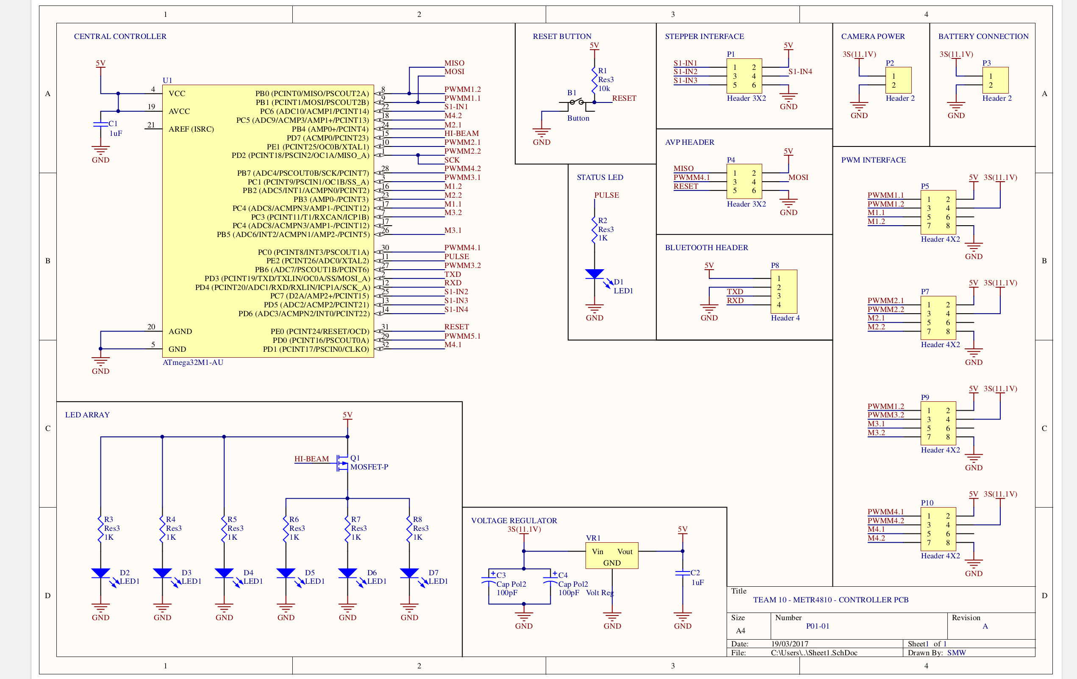
SMW - PCB Design

Slide 6
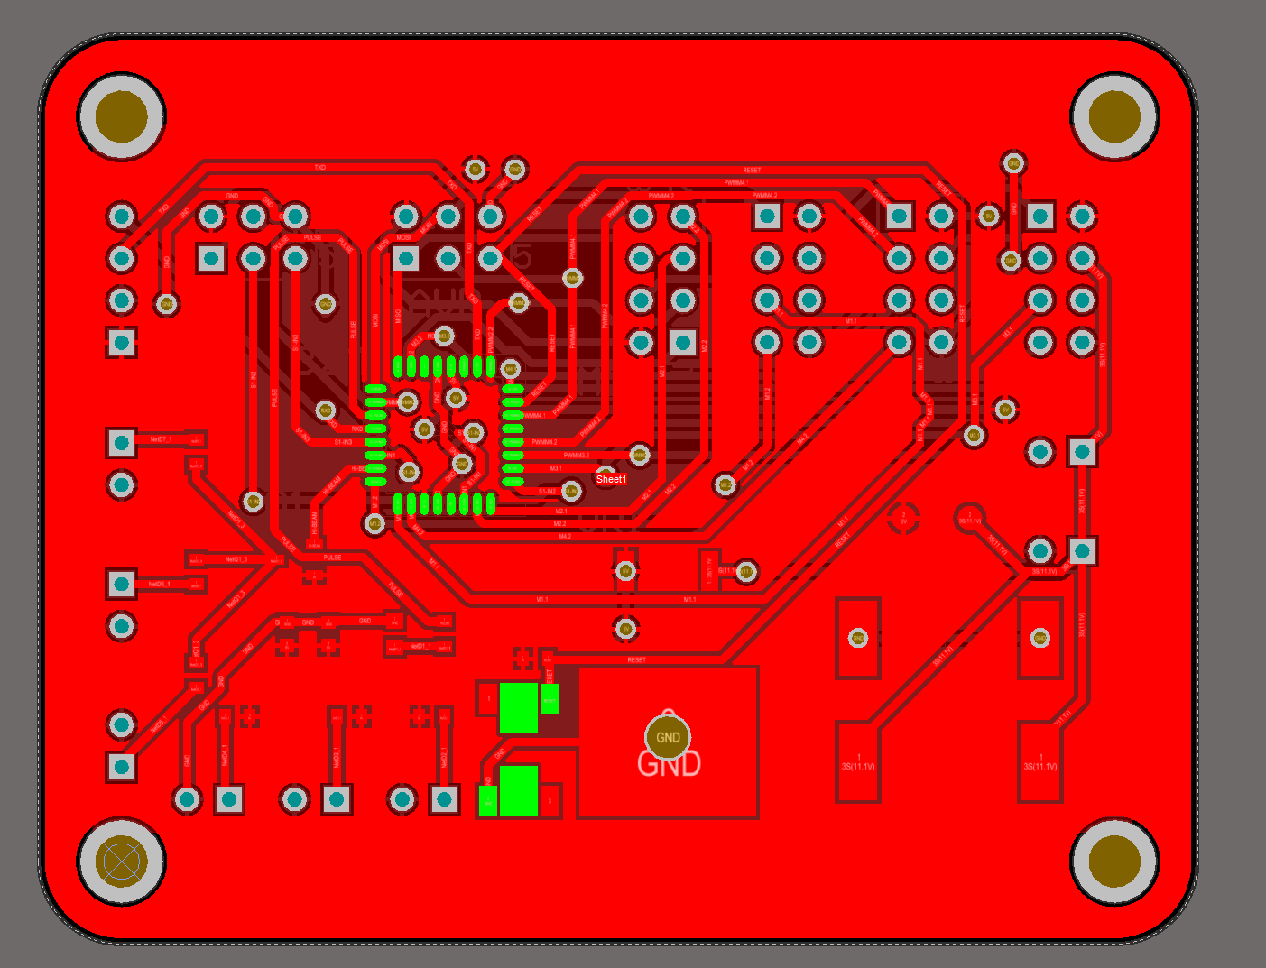
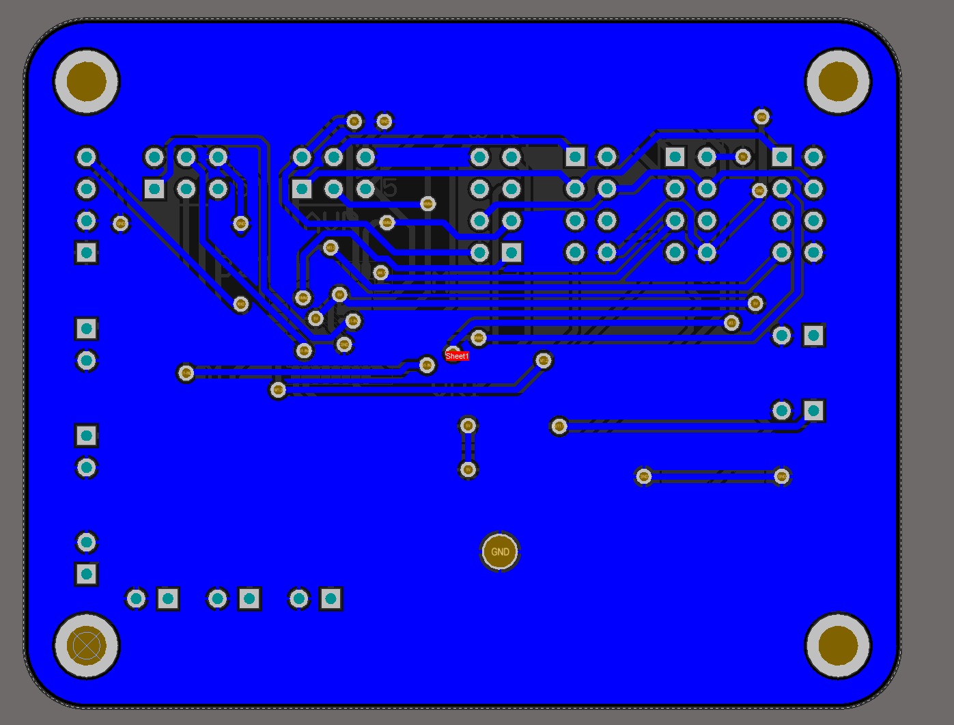
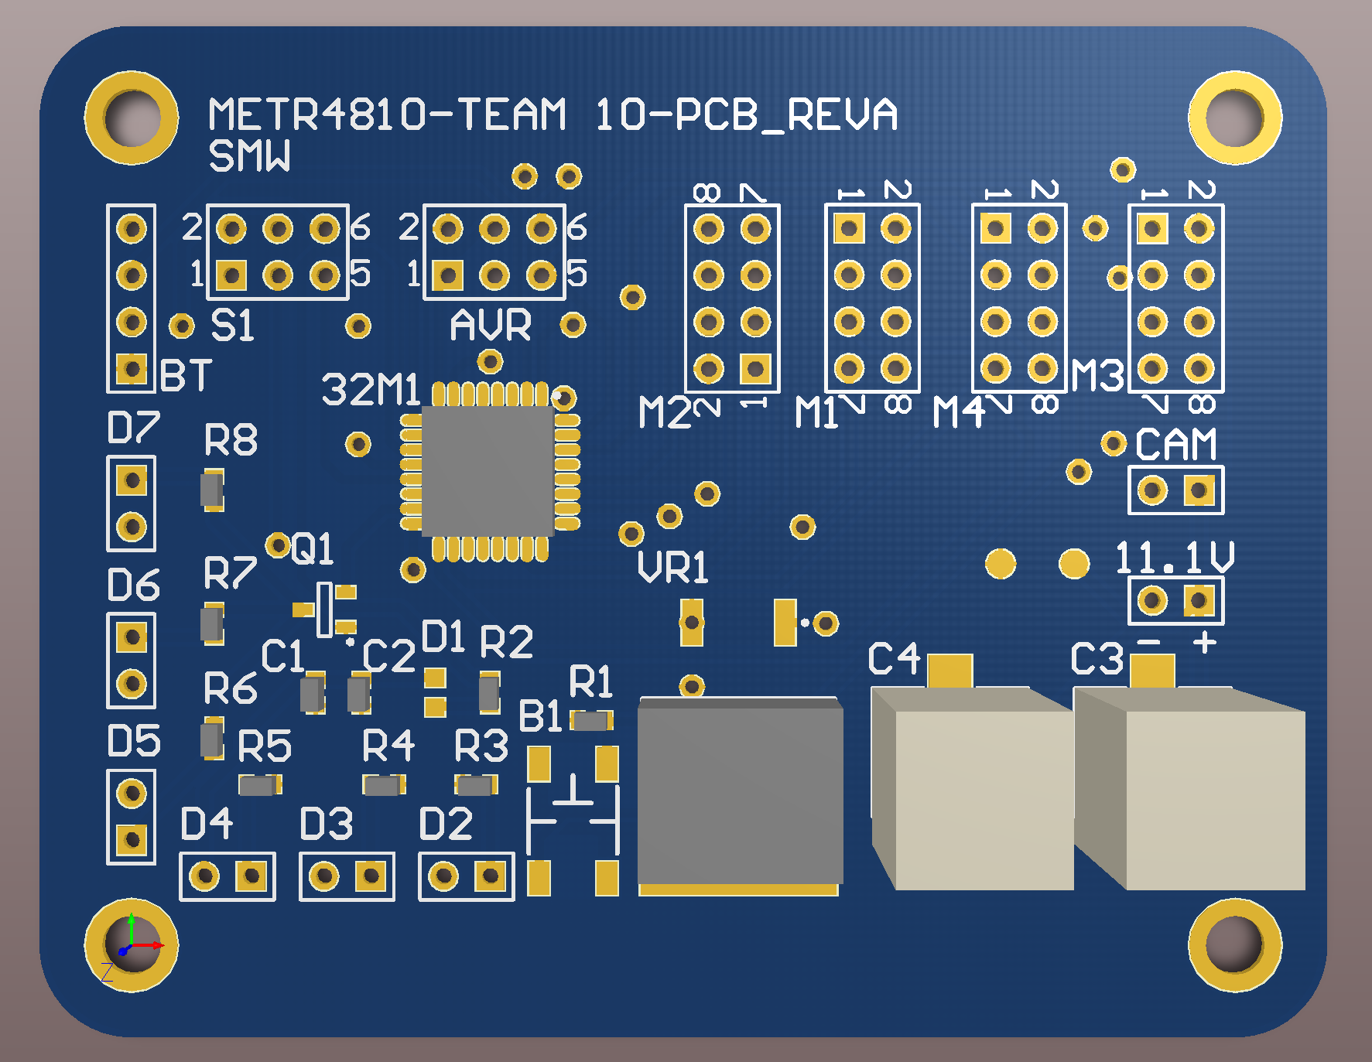
SMW - PCB Design

Slide 7
SMW - Mechanical Build (Buoy)

Slide 8
SMW – Bluetooth Serial Comms.

